Slide 1
The Effect of Immigration on Public Expenditure & Revenue in Ontario: A Data-Driven Analysis
By Saad Ehsan
May 30th, 2025
For
Immigration and Refugee Board
Do you think immigration is a financial gain or strain on public funds

Slide 2
Executive Summary
Immigration is crucial for Ontario’s economy, influencing revenue & public spending.
Immigrants contribute significantly through taxes while also relying on public services.
This study quantifies whether immigrant tax revenue offsets government expenditures.
If immigration accounts for a significant portion of Ontario’s tax base, should policy makers invest more in immigrant integration programs?

Slide 3
Research Objectives & Hypothesis
Objective: Quantify the net fiscal impact of immigration.
Hypothesis: Immigration contributes positively to Ontario’s fiscal balance.
Goal: Provide evidence-based insights for policy recommendations.
A ‘successful immigration policy’ essentially means More skilled labor

Slide 4
Scope & Methodology
Timeframe: 2014–2022 (9-year analysis).
Data Sources: Statistics Canada, Provincial Fiscal Reports, Open Data Portal.
Tools Used: Power BI, Excel, Python (Regression Analysis , Correlation Analysis).
How do you think data-driven models like regression analysis help shape policy decisions?

Slide 5
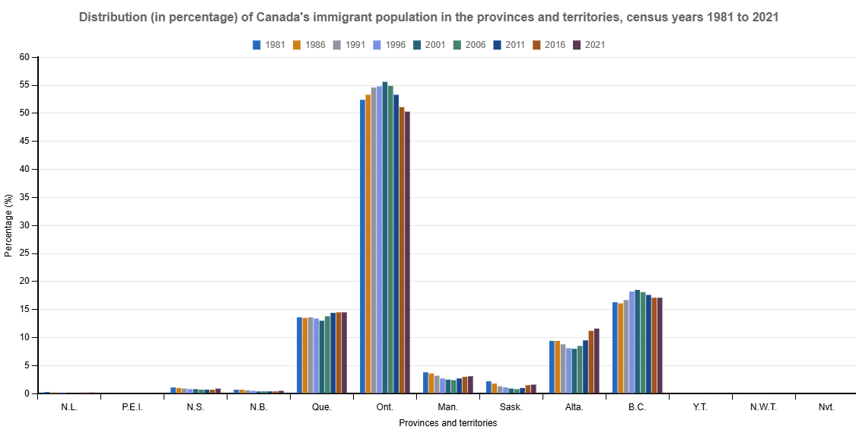
Distribution of Canadas immigrant population in provinces and territories, Census year 2021
Total Population : 40.1 M
Ontario Population : 15.6 M (38.9%)

Slide 6
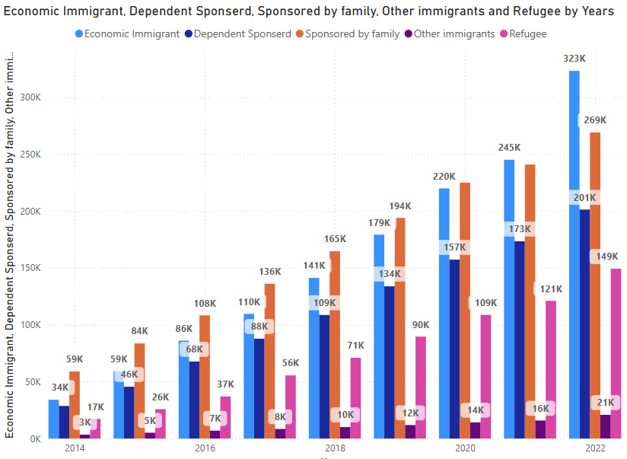
Immigration Trends in Ontario
27.18% increase in average immigration (2014–2022).
Economic Immigrants vs. Refugees vs. Family Sponsorship vs. Dependent breakdown.
Immigration directly correlates with labor market expansion.
Population Growth Contribution: Immigration accounts for 72% of Ontario’s total population growth, reinforcing economic demand and workforce supply.
Urban vs. Rural Settlement Patterns: Immigrants primarily settle in Toronto and then Ottawa, but smaller cities like Hamilton, Cornwall and London have seen growing immigrant populations, affecting regional economic dynamics.
What do you think drives immigrants toward major cities instead of smaller towns?

Slide 7
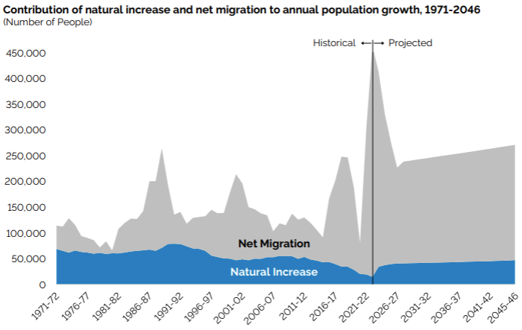
Natural increase and Net migration in Ontario
Source: Statistics Canada for 1971 – 2023, and Ontario Ministry of Finance and projections
What economic challenges might Ontario face if immigration rates decline?

Slide 8
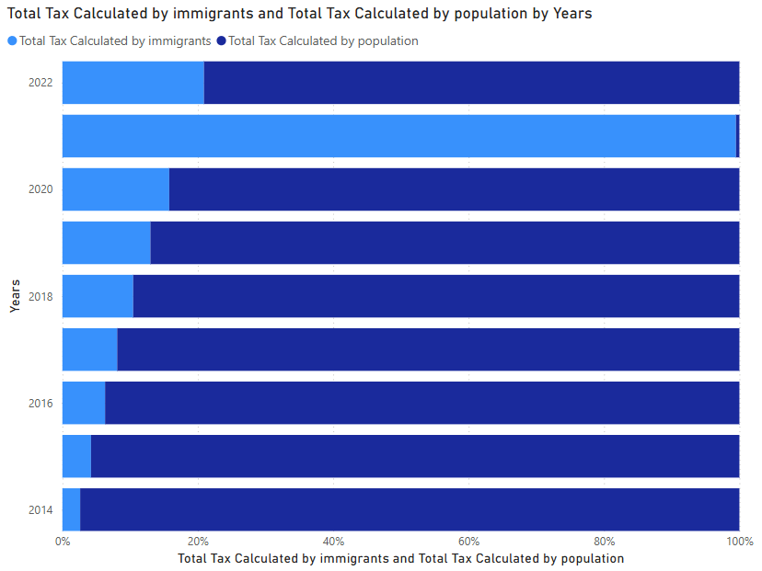
Tax Revenue Growth Analysis
Immigrant tax revenue has a moving average of 38.72%.
Immigrants contribute $78.88 billion vs. non-immigrants $124.84 billion (9 years period, Total tax calculated $203.7 Billion).
Income Distribution Among Immigrants: Economic immigrants tend to earn 13% higher median incomes, contributing more taxable income than family-sponsored newcomers.
Fiscal Return on Immigration Investment: the total increase in government funding is $48.6 Billion. In comparison, the increase in tax revenue collected by immigrants is $78.88 Billion.
What types of jobs do you think contribute the most to Ontario’s tax revenue?

Slide 9
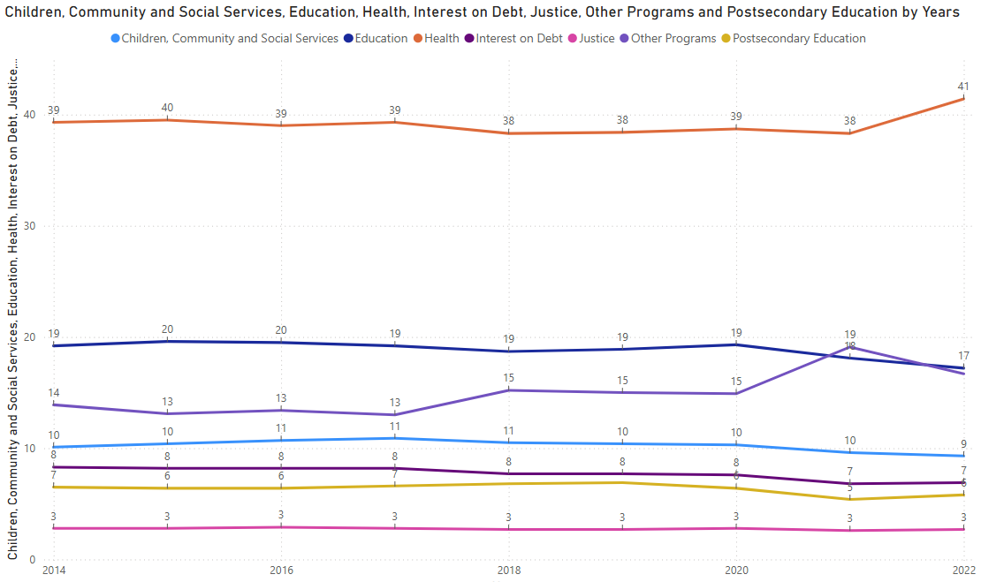
Government Expenditures Breakdown
Annual Expenditure Growth: 3.98%.
Spending fluctuates alongside immigration rates, revealing funding adjustments.
Healthcare Spending: Immigrant families have higher healthcare utilization in early years, but long-term costs stabilize.
Education Investments: Government spends on average $14,501per immigrant student annually in Ontario schools, contributing to skill development.
Social Assistance Allocation: Immigrant reliance on Ontario Works & ODSP is generally decreasing, showing increasing financial independence.
Which public service do you think sees the greatest economic impact from immigration?

Slide 10
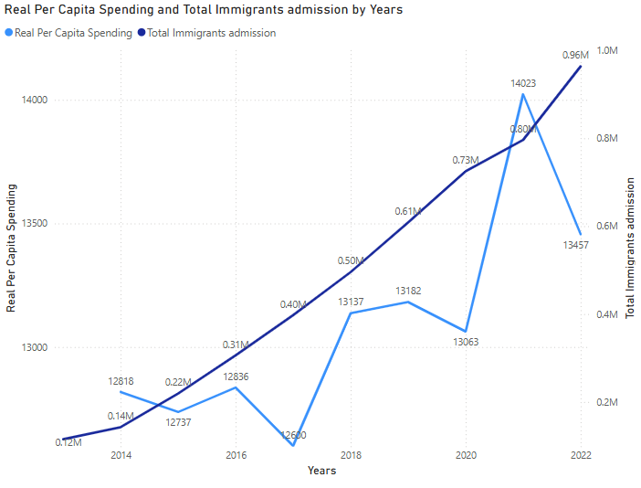
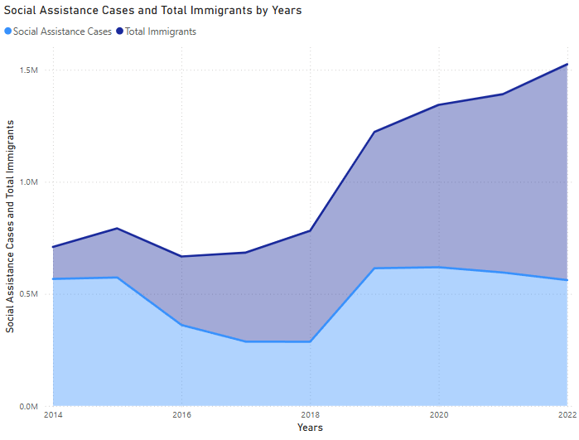
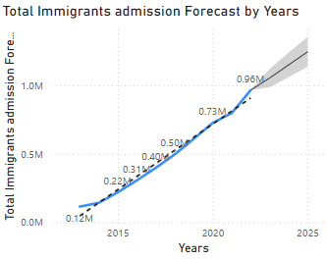
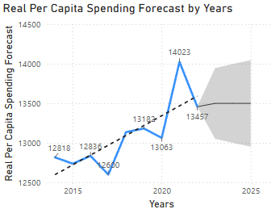
Spending VS Social Assistance VS Immigration

Slide 11
Correlation Analysis
Immigration positively correlates with tax revenue expansion (strong statistical link).
Regression model confirms immigration’s long-term fiscal impact.
Employment Rate Factor: Immigrants in skilled professions contribute more in taxes than non-skilled laborers.
Regional Fiscal Differences: Immigrant-heavy urban centers generate 26% more tax revenue per capita than smaller cities.

Slide 12
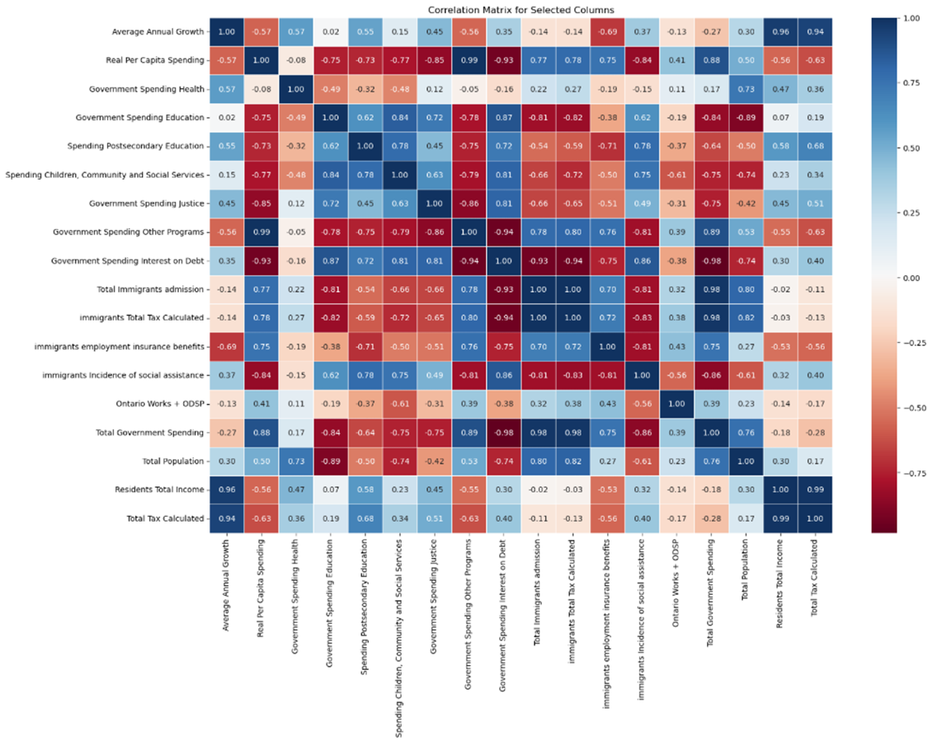
Correlation Analysis

Slide 13
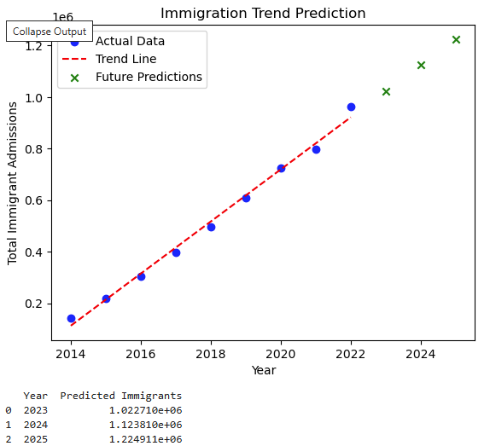
Regression Analysis

Slide 14
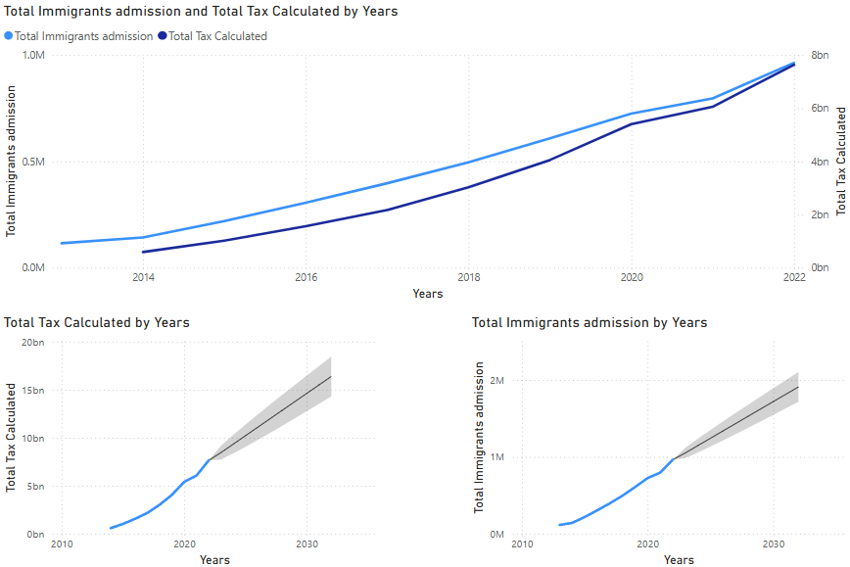
Immigration VS Revenue collected

Slide 15
Fiscal Policy Recommendations
Enhance Workforce Integration Programs (Job Placement & Training).
Optimize Social Assistance (Reduce fiscal inefficiencies & spending misallocation).
Refine Taxation Policy (Better immigrant-focused tax incentives & equal opportunities).
Expand Regional Immigration Initiatives: Encouraging settlement outside Toronto can balance fiscal strain and economic development in smaller cities.
Improve Data Transparency: More granular tax reporting on immigrants vs. non-immigrants can enhance future policy decisions.
Which recommendation do you think would have the biggest impact on Ontario’s economy?”

Slide 16
Conclusion & Final Thoughts
Immigration supports Ontario’s financial stability.
Data proves immigrants contribute more in taxes than they cost in services.
Future research: Expand datasets for more accurate predictions.
Do you believe immigration should be treated as an economic priority in Ontario’s fiscal planning?

Slide 17
Q&A Session & Discussion

Slide 18
Do you think immigration should be viewed primarily as an economic strategy rather than a social policy?

Slide 19
Ontario’s economy depends on skilled immigrants—how can we better integrate them into the labor market while reducing fiscal strain?

Slide 20
With immigration fueling population growth, how should Ontario adjust its healthcare and education budgets to ensure sustainability?

Slide 21
Based on the data presented, how do you think Ontario’s immigration policies should evolve in the next decade?

Slide 22
If immigrants contribute billions in tax revenue, should Ontario offer more targeted tax incentives for newcomers? What impact might this have?

Slide 23
Would decentralizing immigration—encouraging newcomers to settle outside major cities—help balance regional economies? What challenges might arise?

Slide 24
What’s your perspective on social assistance programs for immigrants? Should eligibility criteria be adjusted to focus on long-term financial independence?

Slide 25
Should the government invest more in immigration support programs—or would it be more beneficial to focus on economic self-sufficiency among newcomers?
Thankyou

